Slide 1
DESIGN PROJECT SCHOOL BUS TRACKER
Nathan Rolland
Nidhin t.j.
Harikrishan r.s.
Priyadath Raveendran
Abel Shyam Shibu

Slide 2
ABSTRACT
The project is a mobile app that acts as student’s boarding tracking system in school and institution vehicles.
Our Bus attendance application focuses on students, knowing when the student got on and off the bus.
So when the administrators view the data they can take appropriate actions, especially when a student goes missing.
The scheduled boarding time and the time at which the student boarded the bus can be easily tracked using this system.
This application helps in checking whether the student was on time or not and also bring uniformity in the students.

Slide 3
PROBLEM STATEMENT
There are many safety concerns today
Parents might not be knowing whether their child is going to school punctually
Not able track the routine
During crysis situation:like child missing,children cannot be tracked properly
The institution sometimes not able keep track of students,whether they boarded the bus or not

Slide 4
ADVANTAGES
Improve safety in institutions
Brings trust in parents
Useful for investigation when students are missing
The institution and parents can keep track of students

Slide 5
MODULES
Create qr codes with student information and place it in their ID card.
Create a qr code scanner app.
Scan the qr code from the ID card at the time of entrance and exit.
In time and Out time is recorded when its is scanned first and second time respectively.
The time is being recorded in real time in the spreadhseet using the qr code scanner.

Slide 6
SOFTWARE AND HARDWARE USED
SOFTWARE
MIT APP INVENTOR
GOOGLE SHEETS
QR CODE MAKER
HARDWARE
MOBILE PHONE

Slide 7
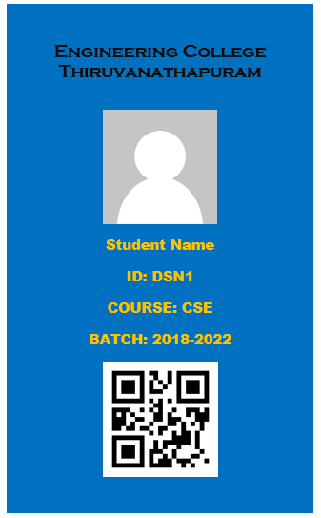
Student ID

Slide 8
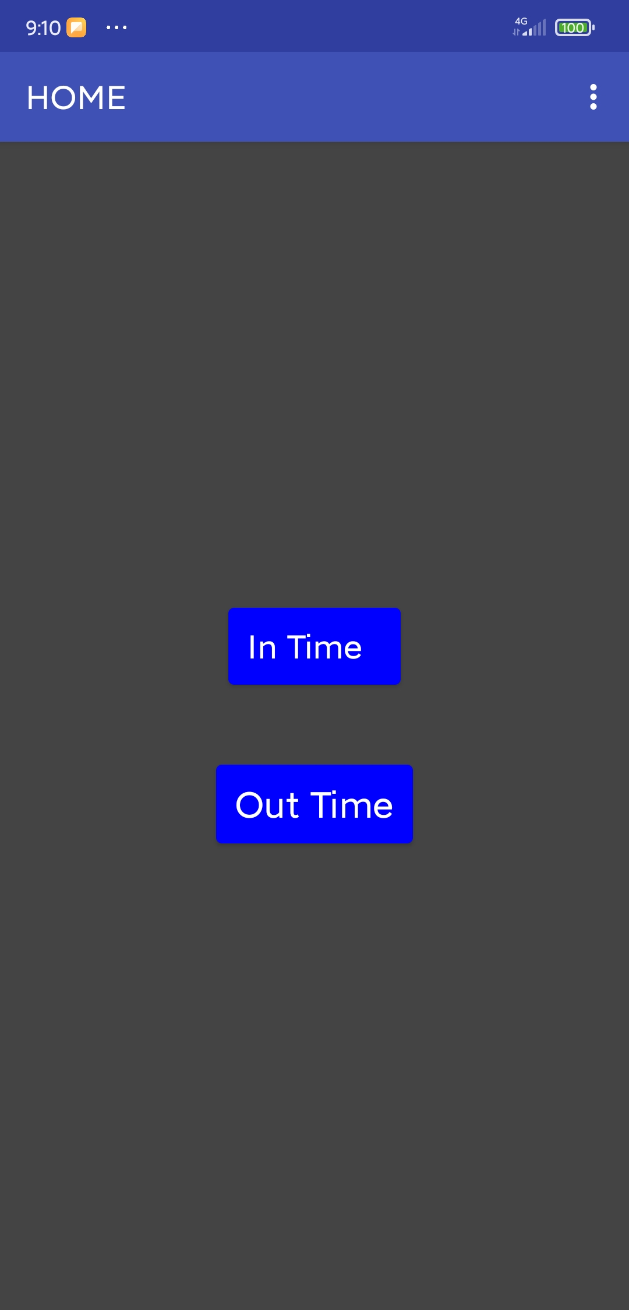
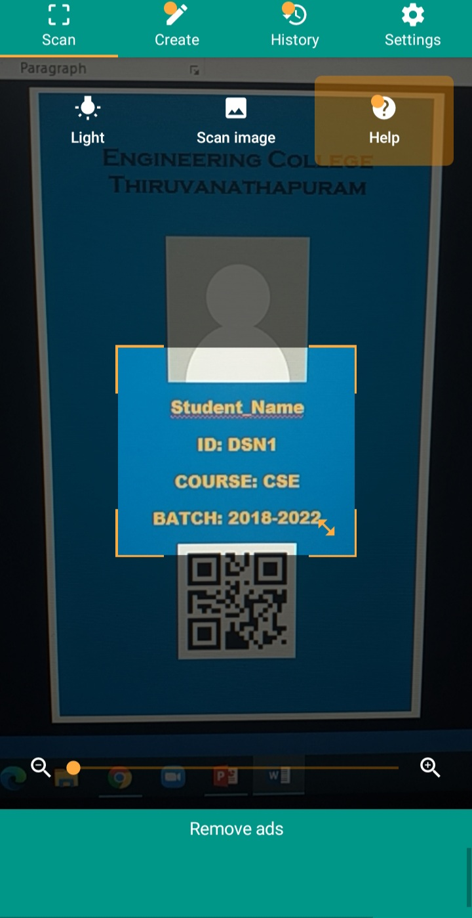
App

Slide 9


APP DEMO VIDEO

Slide 10
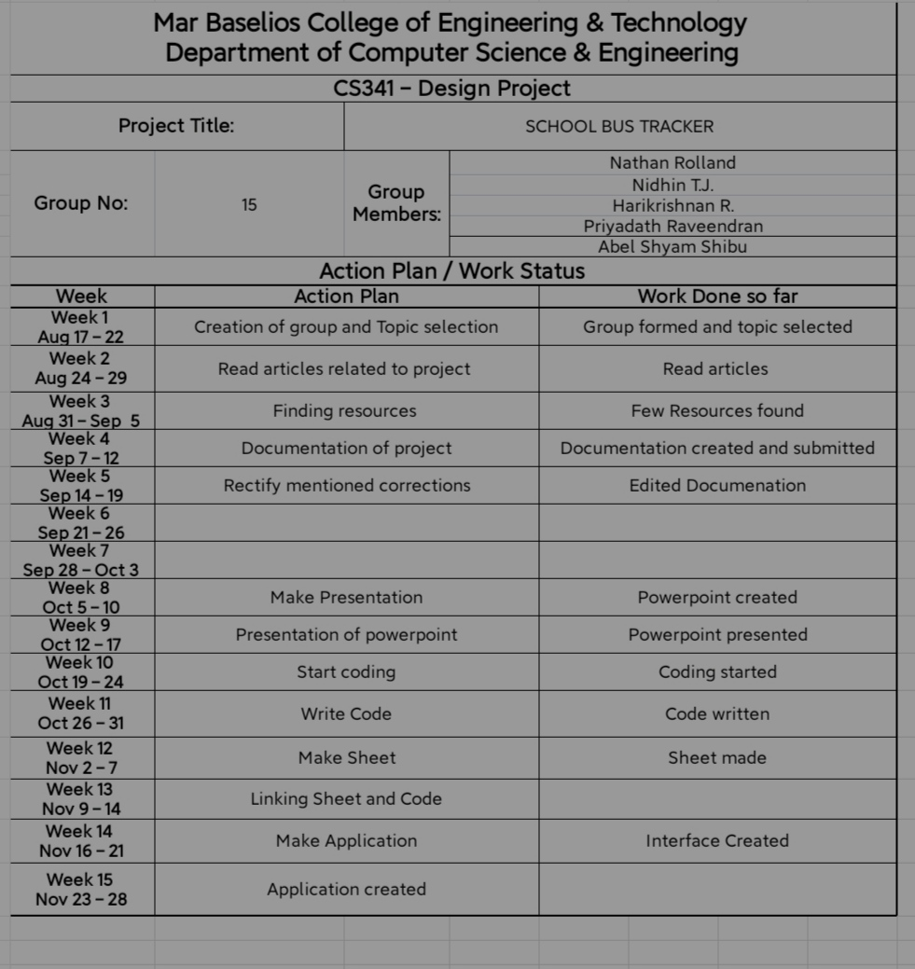
Action Plan

Slide 11
REFERENCES
https://www.the-qrcode-generator.com/
https://appinventor.mit.edu/
https://script.google.com/home

Slide 12
THANK YOU

